Slide 1
Application & Database Assessment Report
By CloudAtlas Tool

Slide 2

Agenda
Application Assessment Details
Summary of Application Readiness & Remediation
Application Migration Strategy
Top Quick Wins – Application Readiness
6R’s Analysis Summary – Applications
Summary of Database Readiness & Remediation
6R’s Analysis Summary – Databases
Top Quick Wins – Database Readiness
Migration Plan

Slide 3


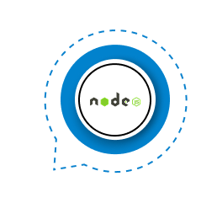
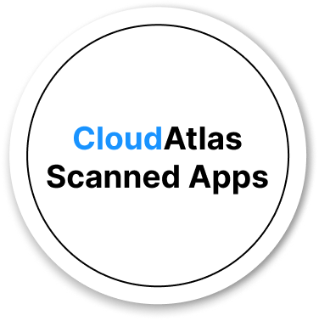


Application Assessment Detail’s
0
Overview
14 applications scanned across .NET
0
14
.NET 14
Java 0
PHP 0
Python 0
NodeJs 0
0
0
CloudAtlas® provided detailed readiness insights for all scanned applications, enabling smooth migration planning.

Slide 4





Summary of Application Readiness and Remediation
Total
Applications
14
.NET
Java
PHP
Python
NodeJs
Azure Migration Approach
Migration Drivers:Cost, Effort, Readiness
Target Workloads:
App Services→ Scalable Web Apps
Azure Functions→ Serverless Execution
Virtual Machines→ Full Control & Legacy Support
Containers→ Portability & Modern Microservices
Outcome:Optimized performance with minimal disruption
14
0
0
0
0
PaaS
App Service
14
Azure function 0
Virtual Machine 14
Container
14
$4088
$0
$6653.22
$7685.44
Total Cost
731 Hours
0 Hours
411 Hours
653 Hours
MigrationEfforts
176
0
160
165
Recommendations
84.93%
0%
86.5%
85.93%
Readiness

Slide 5


Summary of Application Migration Strategy
Migration Strategy
Based oncost,effort, andreadiness, workloads are mapped to the appropriate platforms—
App Services
Azure Functions
Virtual Machines
Containers
The right section highlights thetotal migration cost and effort, providing a clear view of investment and resources
TotalApplications
14
App Service 14
$4088
Total Cost
Azure Function 0
Virtual Machine 0
731 hours
Migration Efforts
Container 0

Slide 6

Top Quick Wins of Application Readiness
Criteria for quick win apps.
Easier and faster to migrate applications.
Low complexity→The application is straightforward, so it can be moved with minimal effort.
Less migration blocker→There are no technical or business constraints stopping the migration.
Fewer dependencies→The app doesn’t rely much on other systems, making the migration simpler and less risky.
Quick Wins
Application | Readiness (%)
PEI | 95
South Africa | 95
SIMReportes | 95
Tell MeReports | 95

Slide 7
6R'S Analysis Summary For Applications
14
14
0
Python
TotalApplications
.NET
Java
0
PHP
0
NodeJs
0
Application
0
Application
14
Efforts (hrs)
0
Rehost
Refactor
Efforts (hrs)
731
Analysis Details of6differentphasesincloud migration strategy
Readiness(%)
0.00
Readiness(%)
84.93
6 R’s Analysis
Application
0
Replace
Rebuild
Application
0
Efforts (hrs)
0
Application Migration strategy
Efforts (hrs)
0
Readiness(%)
0
Readiness(%)
0
Application
0
Application
0
Efforts (hrs)
0
Retain
Rearchitect
Efforts (hrs)
0
Readiness(%)
0
Readiness(%)
0.00

Slide 8

Summary of Database Readiness and Remediation
Total
Databases
14
Total Servers
2
Database Instance
2
Database Migration Approach
serv Serversand2Database Instancesready for migration.
Azure SQL MI 14 db's Majority of db's move on sqlmi because they have no migration blockers and need minimal effort.
Azure SQL MI
Azure SQLVCore
Azure SQL VM
$5866.00
$49705.23
$9228.00
Total Cost
168 Hours
224 Hours
236 Hours
MigrationEfforts
42
54
65
Recommendations
100%
95.14%
86.5%
Readiness

Slide 9
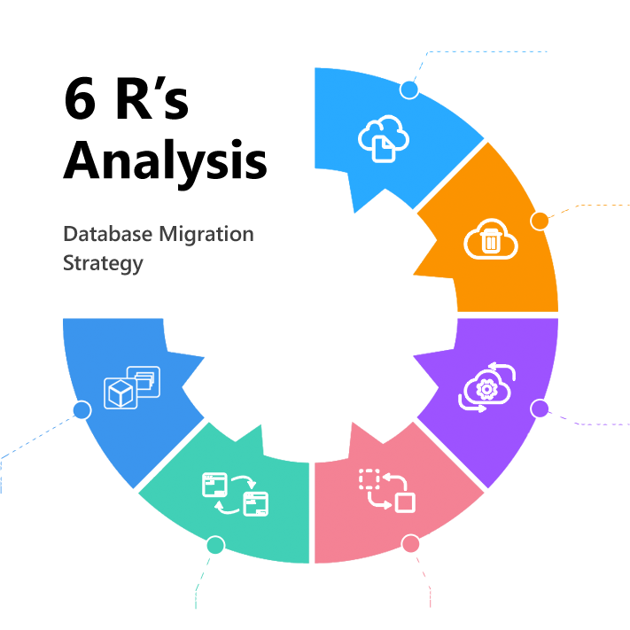
6R'S Analysis Summary For Database
Analysis Details of6 phases
ofDatabase Migration Strategy
TotalDatabases
Retain
14
Database 0
Replace
6 R’s | Database | Platform
Rehost | 0 | NA
Refactor | 0 | NA
Rebuild | 0 | NA
Rearchitect | 14 | SqlMI
Retain | 0 | NA
Replace | 0 | NA
Database 0
Rebuild
Database 0
Rehost
Database 0
Refactor
Rearchitect
Database 0
Database 14

Slide 10
Top Quick Wins of Database Readiness
Criteria for quick windb’s.
Easier and faster to migrate databases.
Low complexity→The database’s is straightforward, so it can be moved with minimal effort.​
No migration blocker→There are no technical or business constraints stopping the migration.​
Fewer dependencies→The database' doesn’t rely much on other systems, making the migration simpler and less risky.
Quick Wins
Database | Readiness (%)
MIE | 97
Parametrics | 97
RubOnlineLog | 97
SIM2010LOG | 97

Slide 11




Migration Plan
Applications and Databases
Wave Plan
Applications
14
Migration Waves
4
Total
Groups
6
.Net 14
Java 0
Php 0
Python 0
Databases
14
Mysql 0
PostgreSQL 0
Mariadb 0
MongoDB 0
MSSQL 14
Oratopg 0
Waves | Groups | Server | Application | Database | Complexity Score(Low) | Complexity Score(medium) | Complexity Score(High)
Wave 1 | 1 | 1 | 8 | 0 | 24 | 0 | 0
Wave 2 | 2 | 2 | 7 | 1 | 21 | 0 | 0
Wave 3 | 1 | 1 | 7 | 7 | 21 | 0 | 0
Wave 4 | 2 | 2 | 6 | 6 | 18 | 0 | 0

Slide 12
ThankYou
We appreciate your time and attention

